Slide 1
Title of the paper: Predicting the IMDB rating by using EDA and Machine Learning Algorithms (Dixit,Hussain,Singh,2020)
BY
ANANYA PATTNAIK, ANMOL TULI
(22030121023),(22030121028)

Slide 2
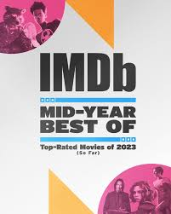
Abstract and Keywords
Abstract:-
The film industry is a significant source of entertainment, employment, and business. Famous actors and directors may boost a movie's publicity, but they can't guarantee a high IMDb score. To predict IMDb ratings, we collected online data on Hollywood movies and created a dataset. We performed exploratory data analysis and applied various machine learning algorithms. We identified the best-fit algorithm for accurate IMDb rating predictions.
Keywords:
Exploratory Data
Regression
Multiclass Classification.
Machine Learning Algorithms

Slide 3
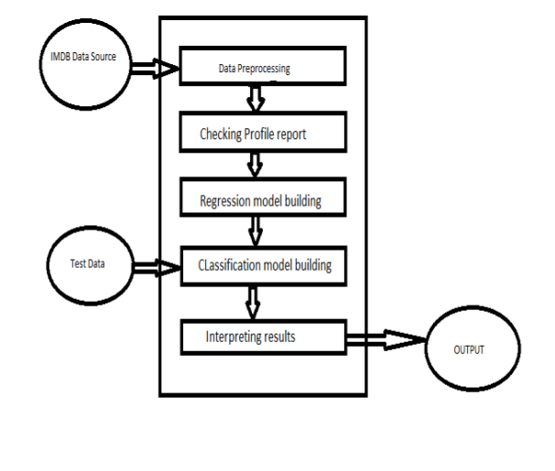
Introduction & Literature review
Introduction
Viewers seek information about movies before watching them. Movie trailers are limited, and IMDb ratings provide valuable insights.
This research paper introduces a model predicting IMDb ratings using factors like duration, budget, genre, and language. Historical data aids in assessing upcoming movie success with high accuracy.
The sections cover data collection, algorithms, results, and conclusions.
Literature Review
The literature review offers a thorough look at the dynamic field of predicting movie ratings, highlighting its evolution and ongoing relevance in the data-driven film industry. Paper involves:
Movie rating prediction using machine learning which is a burgeoning field.
Studies have explored attributes like genre, director, and actors for predictions.
Ensemble models and SVMs are promising tools for IMDb rating forecasts.

Slide 4
Research Methodology & Conclusion
RESEARCH METHODOLOGY
HYPOTHESIS
The research methodology involves building two types of models, regression and classification, to predict IMDb ratings based on movie data.
The regression model selection process included data preprocessing, missing value treatment, outlier analysis, and converting categorical variables to numerical ones. Various Regression algorithms like Simple Linear Regression and Support Vector Machines with various kernels are considered with XG Boost performing the best with the lowest mean squared error.
In the classification model building process, Three techniques are applied: Logistic Regression, Support Vector Classifier, and Ensemble Models. Random Forest, Gradient Boosting, and XG Boost classifiers are used with hyperparameter tuning.
Methods used:,Exploratory Data Analysis (EDA) for data exploration, feature engineering, and machine learning algorithms, such as Linear Regression, Support Vector Machines, Gradient Boosting, Random Forest, and XG Boost, for building regression and classification models.
The hypothesis for the research paper "Predicting the IMDB rating by using EDA and machine learning Algorithms" could be as follows:
Null Hypothesis (H0): Movie attributes, such as duration, budget, genre, and language, have no significant predictive power in determining IMDb ratings.
Alternative Hypothesis (H1): Movie attributes, such as duration, budget, genre, and language, significantly influence and predict IMDb ratings.
The paper doesn't provide information about which hypothesis (H0 or H1) was found to be true after their calculations. Process: if sample size(n) >30 z-test would have been performed else t-test will be considered. if |z-cal| < 1.96 at 5% level of significance then H0 will be accepted else H1.Similarly, accept H0 if |t-cal| < [ t (n-1); α/2;0.025] else accept H1 at 5% level of significance.

Slide 5
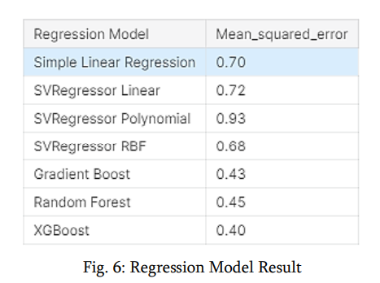
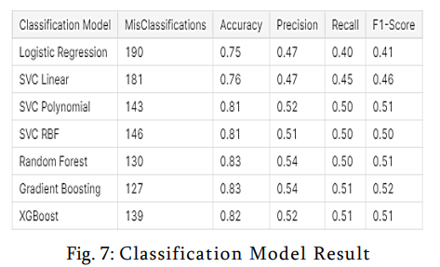
Conclusion
In summary, our research created models for IMDb rating prediction, with XG Boost standing out as the optimal regression model with the lowest mean squared error and Gradient Boosting achieved 83% accuracy in movie success classification(i.e. Classification Building Model).
HENCE The XG Boost and Gradient Boosting will be preferred for similar predictions in future.
These models help viewers make more informed and enjoyable movie selections, enhancing their cinematic experience.
The adaptable datasets remain relevant as new movies release, offering valuable tools for data enthusiasts and analysts in the dynamic film industry.

Slide 6
Relevance of paper
Movie Industry: The research offers valuable insights for the movie industry. Movie studios and producers can benefit from predicting IMDb ratings to understand potential success, allocate resources effectively, and improve their films.
Viewers: Movie enthusiasts can make more informed choices by using the predictive models to anticipate movie quality and suitability to their preferences.
PERSONALISED MOVIE RECOMMENDATIONS:
Another real-life example that can be addressed using these techniques(especially the classification model building process) is personalized movie recommendations:
By analyzing a user's preferences, historical movie ratings, and other attributes, the models can predict which movies a viewer might enjoy, enhancing the movie-watching experience and providing tailored recommendations through streaming platforms.

